Slide 1
Paragraph Writing

Slide 2
What?
Cluster of sentences that come under one theme, matter or one subject is known to be called as a paragraph.
A paragraph has a group of sentences that support one main idea.
The unity and coherence of ideas among sentences is what constitutes a paragraph.

Slide 3
Why?
Paragraph is used as a portion of a formal writing.
Paragraph is the main backbone of any academic or non-academic writing.

Slide 4
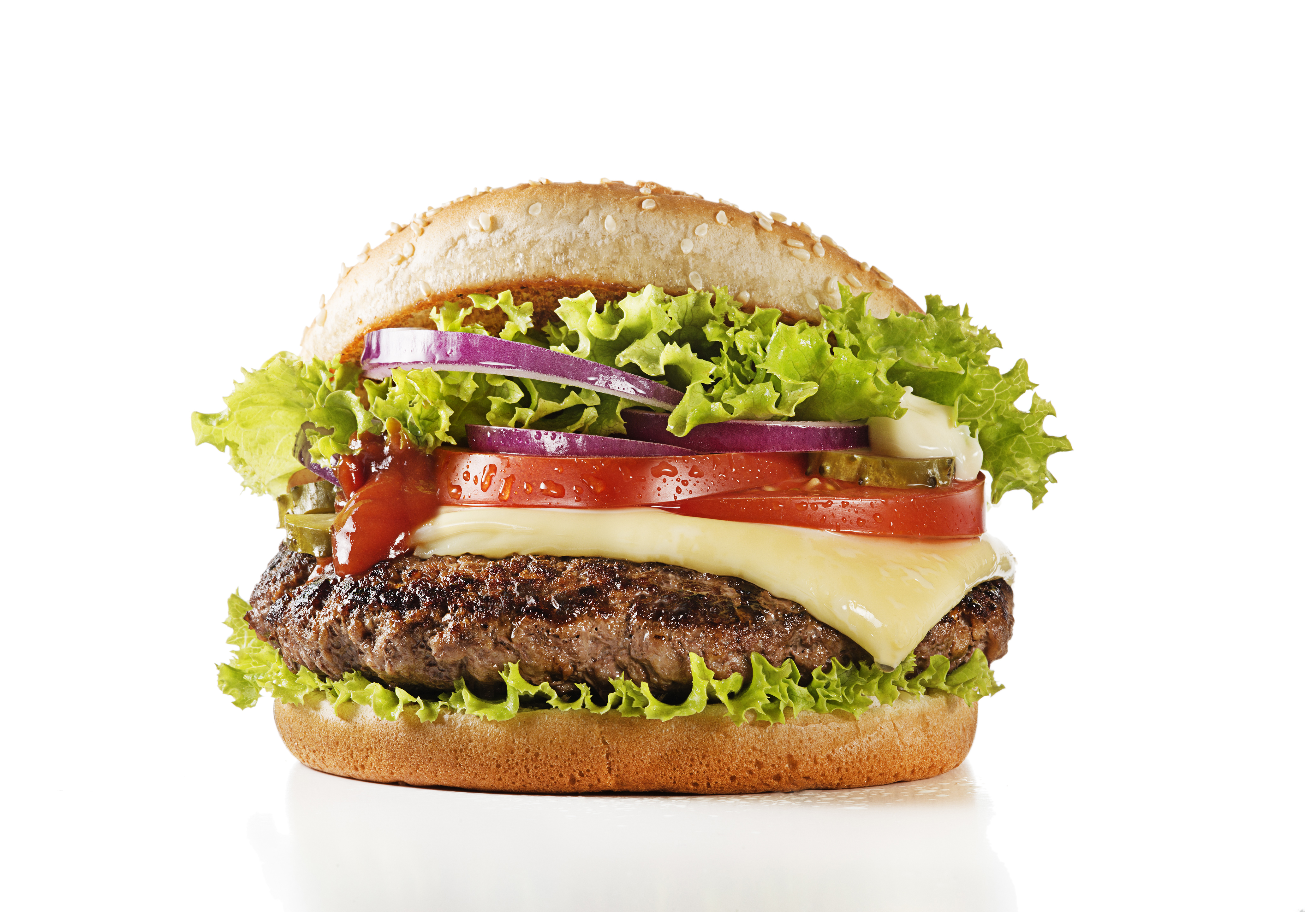
Think of a burger as a Paragraph

Slide 5
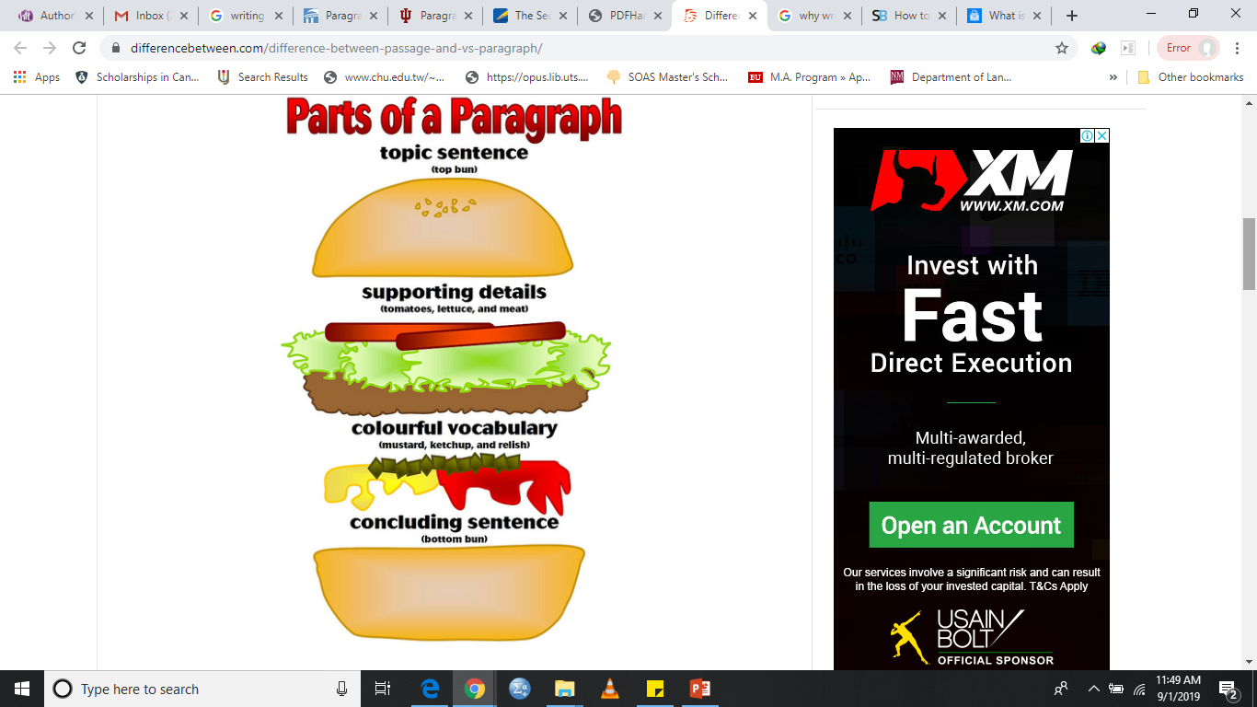
How?

Slide 6
How?
Topic Sentence
Supporting Details
Major Supporting Details
Minor Supporting Details
Concluding Sentence

Slide 7
Topic Sentence
First sentence in a paragraph.
The topic then what you want to say (controlling idea)/Stance about that topic.
Topic Sentence = Topic + Controlling Idea
Examples:
1. People can avoid plagiarizing by taking certain precautions.
People can avoid plagiarizing by taking certain precautions.
2. There are several advantages to online education.
There are several advantages to online education.
3. Leadership requires specific qualities that anyone can develop.
Leadership requires specific qualities that anyone can develop.

Slide 8
Explaining the Controlling idea (Supporting Details)
After stating topic sentence, it is necessary to further elaborate your controlling idea to complete a paragraph.
The writer explains his/her thinking about the main topic, idea, or focus of the paragraph.
The writer either uses major details for further explanation or uses both major and minor details for elaboration of controlling idea.

Slide 9
Concluding Sentence
The concluding sentence is the last sentence in the paragraph.
It draws together the information presented to elaborate controlling idea by:
Writing a rephrased version of the topic sentence.
Repeating words or phrases from the topic sentence.
Using linking words that indicate that conclusions are being drawn (e.g., therefore, thus, resulting)

Slide 10
Sample Paragraph
Miami is a wonderful place to visit. Miami has great beaches. You can go to South Beach, which is a fun, young exciting beach. You will see people playing volleyball on the beach and always having a party. If you are with young children, you will want to go to Hollywood Beach, as it is set up for kids with an amazing boardwalk and places for them to ride bicycles. Miami has incredible sporting events. You can catch the thrill and excitement when you go and watch the Heat win all their games. We also have the Miami Dolphins football team and the Marlins baseball team. If you enjoy tennis, then you can go to the Key Biscayne tournament, which is held every year. Miami has perfect weather. You can come to Miami in December and the temperature will be 75ºF.

Slide 11
Sample Paragraph
Miami is a wonderful place to visit. Miami has great beaches. You can go to South Beach, which is a fun, young exciting beach. You will see people playing volleyball on the beach and always having a party. If you are with young children, you will want to go to Hollywood Beach, as it is set up for kids with an amazing boardwalk and places for them to ride bicycles. Miami has incredible sporting events. You can catch the thrill and excitement when you go and watch the Heat win all their games. We also have the Miami Dolphins football team and the Marlins baseball team. If you enjoy tennis, then you can go to the Key Biscayne tournament, which is held every year. Miami has perfect weather. You can come to Miami in December and the temperature will be 75ºF.

Slide 12
Sample Paragraph
A paragraph consists of a number of sentences that have a particular role to play in writing a paragraph. The topic sentence, which usually appears at the beginning of the paragraph, states the main point of the paragraph and also indicates how the paragraph will be developed. The other sentences in the paragraph, known as the supporting sentences, develop the main idea in the topic sentence. The last sentence in a paragraph is often a concluding sentence. Thus, multiple sentence join together and constitute a paragraph.

Slide 13
Sample Paragraph
Assignment essay tasks are set to assist students to develop mastery of their study subject. Firstly, assignment tasks enhance understandings about subject matter. Yang and Baker (2005, p. 1) reason that “to master your learning materials and extend your understandings, you need to write about the meanings you gain from your research”. Secondly, students learn the writing conventions of a subject area while they are researching, reading and writing in their discipline. This activity helps them to “crack the code” of the discipline (Bloggs, 2003, p. 44). Thus, students are learning subject matter and how to write in that disciplinary area by researching and writing assignment essays.

Slide 14
Sample Paragraph
Assignment essay tasks are set to assist students to develop mastery of their study subject. Firstly, assignment tasks enhance understandings about subject matter. Yang and Baker (2005, p. 1) reason that “to master your learning materials and extend your understandings, you need to write about the meanings you gain from your research”. Secondly, students learn the writing conventions of a subject area while they are researching, reading and writing in their discipline. This activity helps them to “crack the code” of the discipline (Bloggs, 2003, p. 44). Thus, students are learning subject matter and how to write in that disciplinary area by researching and writing assignment essays.

Slide 15
Write a paragraph (80-100 words) on “Effects of COVID-19 on Students’ Mental Health”
Paragraph Rubric
Paragraph Organization | Quality of Ideas | Cohesion | Sentence Structure | Punctuation | Vocabulary | Word Count | Total
1-3 | 1-3 | 1-2 | 1-2 | 1-2 | 1-2 | 0-1 | 15

Slide 16
Online Activity
https://www.victoria.ac.nz/llc/llc_resources/academic-writing/index.html
Exercise 1.1
Exercise 1.2
Exercise 2.1
Exercise 2.2
Exercise 2.3
Exercise 2.4
Exercise 3.1
Exercise 3.2

